Slide 1
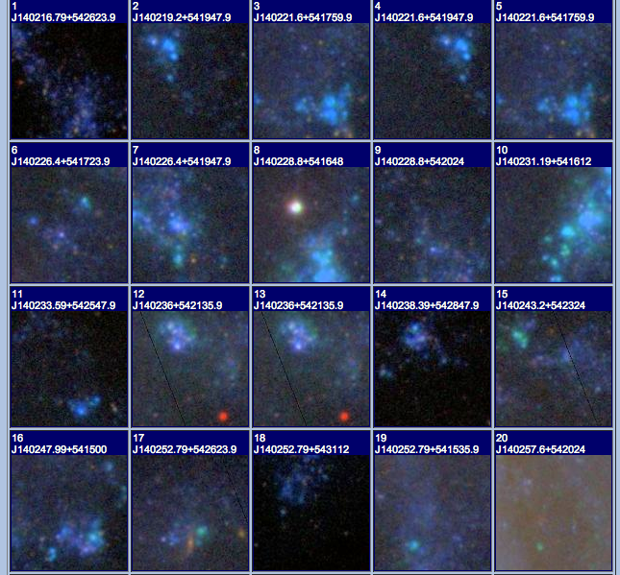
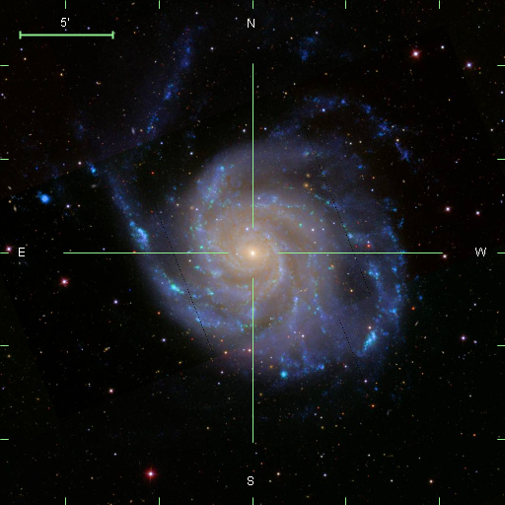
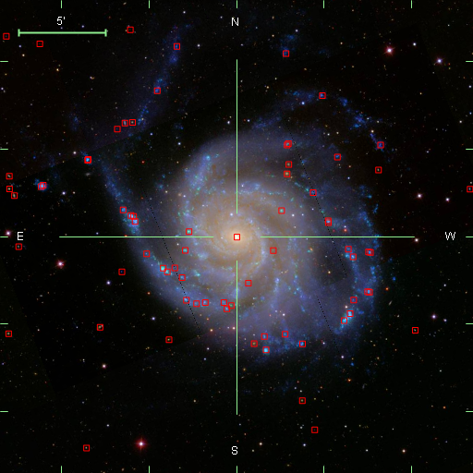
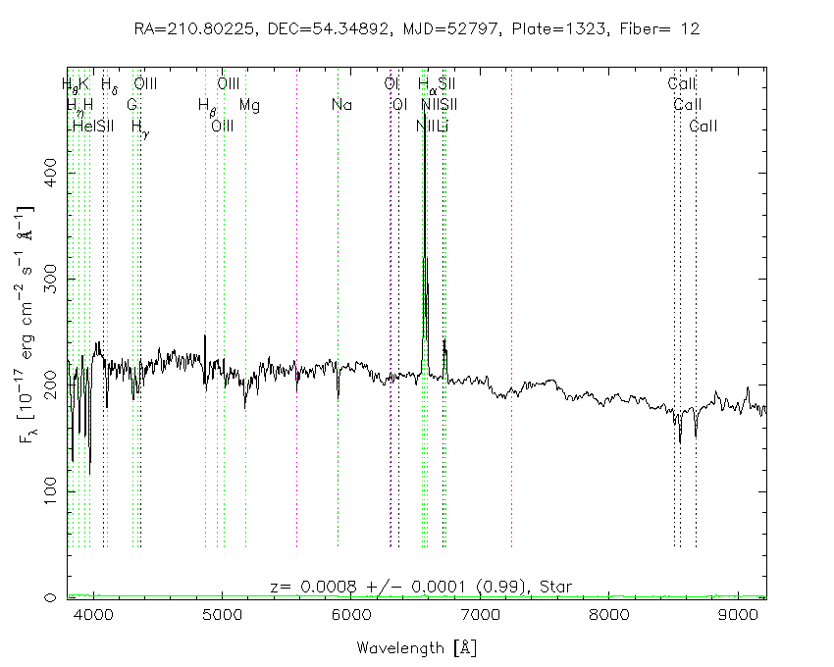
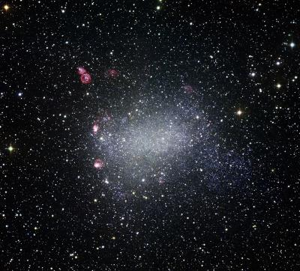
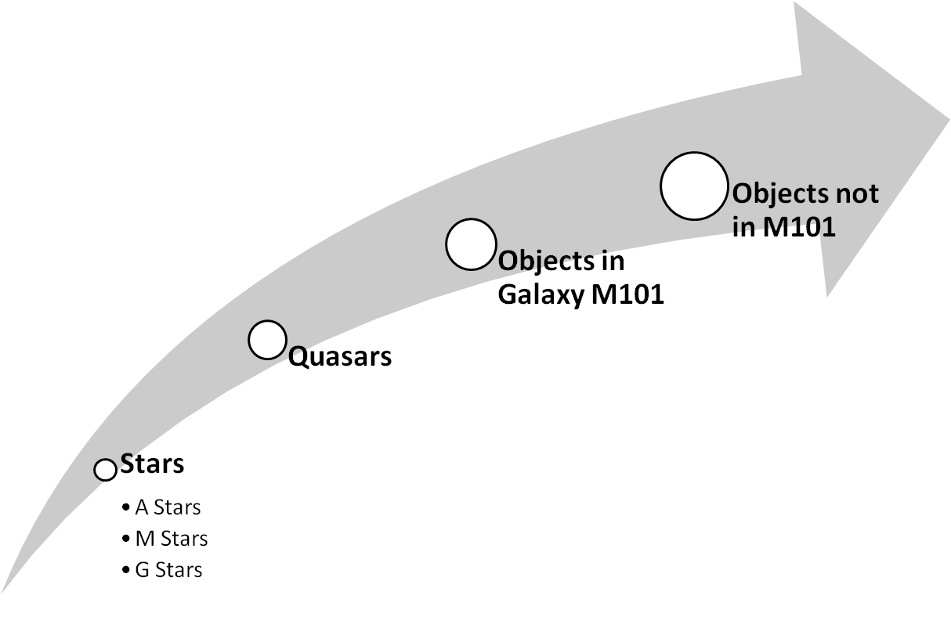
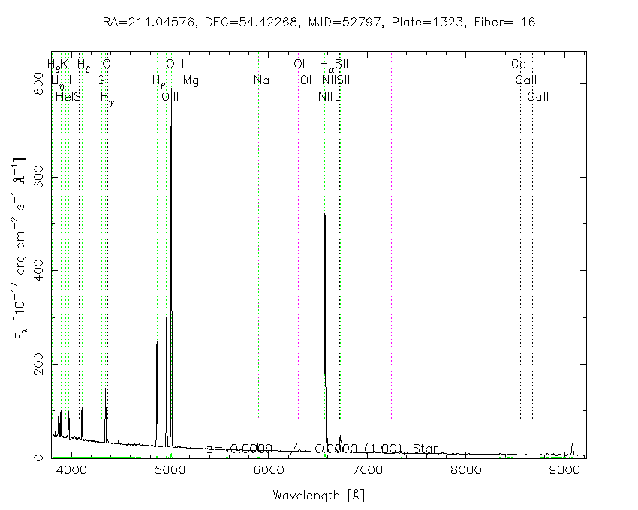
M101
George Washington High School
Alvin Anthony ,Destiny Marie G. , Brenda Juarez, Blanca Chavez
University of Chicago.
Objective
M101
Procedure
M101
This project was part of an experiment to test if we could use large astronomical databases to carry out a science project.
After discussing possible projects we choose to explore the different objects in and around galaxy M101 by using SQL search. As far as we know no one has ever done this project before.
M101 is a beautiful spiral galaxy and its redshift range is about .0005 - .0009 and is approximately 5 megaparsecs away.
.
Even though it is not as guaranteed as looking at an objects spectrum, looking at the image can really help identify a simple mistake in classification.
To further explore the contents of M101 we then decided to classify them by spectral type.
High Continuum High Ha,
High Continuum High O111,
Low Continuum High Ha,
Low Continuum High O111,
“Odd Balls”
The objects above are 20 of the 53 objects that belong to galaxy M101.
From the data collected using M101 it was likely we would find many objects with high H-alpha because most of the objects in our galaxy are just glowing gas clouds or hot stars. We were surprised to see so many objects with low continuum.
SDSS Spectrum of the Center of M101
Initial Exploration
We examined the image of M101 from the Sloan Digital Sky Survey (SDSS) and noticed that the further away one gets from the center of the galaxy the bluer the objects get. The light from any part of the galaxy is starlight from millions of stars. Since hotter stars emit blue light, we suspected that the stars at the edge of the galaxy are generally hotter. The continuum of the galaxy can reflect on the objects stellar population so by examining the spectra of objects in M101 we can test our suspicion.
SDSS acquired about 350 objects with spectra in and around M101 which we found using an SQL search. We divided the objects among each other and classified each object by the spectral type (shown on the picture below). There were 53 spectra of objects in M101 and we noticed that the spectra fall into different classes.
M101
M101
Instead they were in a nearby Dwarf Galaxy. This galaxy orbits around M101.
Even though our cut offs for objects that belonged to galaxy M101 were .0005-.0009 there were 9 objects that weren't actually in our galaxy.
SDSS Spectrum of an object on the edge of M101
M101
Results and Conclusion

